Slide 1
Theory of Computation
Introduction
2nd Semester 2017-2018
Dr. Abdulhussein M. Abdullah
Lec #1

Slide 2
الامتحان الاول : الاربعاء 25/4/2018
الامتحان الثاني : الاربعاء 23/5/2018
الدرجات
30 درجة (امتحان1 + امتحان2)
20 درجة واجبات بيتية + quizes
الامتحانات اليومية مفاجئة و تكون بمحاضرات الاسبوع الماضي.
عند حصول غش في الواجبات البيتية تحسب 0 من 20.
يمكن للطالب مغادرة القاعة والعودة لها بدون اخذ اذن مني.

Slide 3
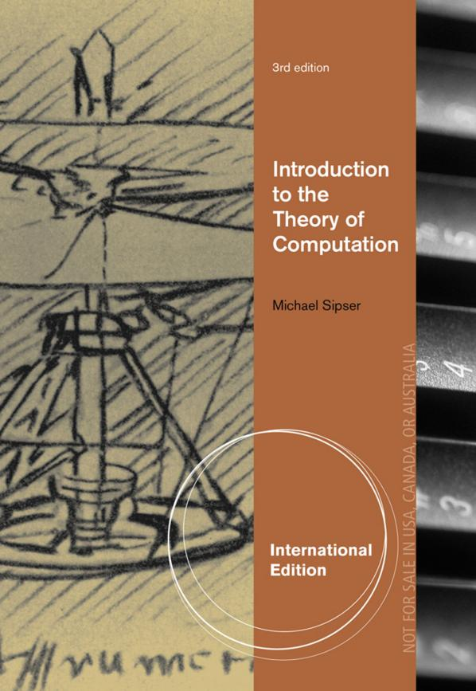
Textbook

Slide 4
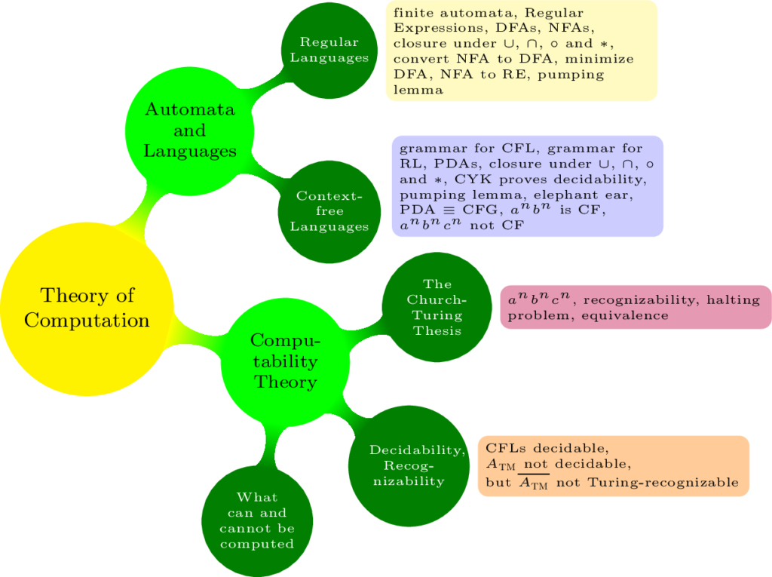

Slide 5
Three fundamental questions
What can be computed?
(Computing models and computability)
What can be computed efficiently?
(Complexity)
How can we build practical computing devices and systems?
(Architectures and Systems)

Slide 6
Objective
Make a theory out of the idea of computation.

Slide 7
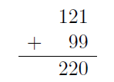
What is “computation”?
“Processing of information based on a finite set of operations or rules.”
• Paper + Pencil Arithmetic
• Abacus
• Calculator w/moving parts (Babbage wheels, Mark I)
• Ruler & compass geometry constructions
• Digital Computers

Slide 8
What do we want in a “theory”?
• Generality
• Technology-independent
• Abstraction: ignores inessential details
• Precision
• Mathematical, formal.
• Can prove theorems about computation, both positive (what can be computed) and negative (what cannot be computed).

Slide 9
Representing “Information”
• Alphabet
Ex: a, b, c, . . . , z.
• Strings: finite concatenation of alphabet symbols, order matters
Ex: qaz, abbab
ɛ = empty string (length 0; sometimes e)
• Inputs (& outputs) of computations are strings.

Slide 10
Computational Problems (i.e. Tasks)
A single question that has infinitely many different instances
• given a string x, does it have an even number of a’s?
• given a string x, does it have more a’s than b’s?

Slide 11
Examples of computational problems on numbers
• ADDITION: given two numbers x, y, compute
x + y.
• PRIMALITY: given a number x, is x prime?

Slide 12
Examples of computational problems about computer programs
• SYNTACTICALLY CORRECT C PROGRAM: given a string of ASCII symbols, does it follow the syntax rules for the C programming language?
• HALTING PROBLEM: given a computer program (say in C), can it ever get stuck in an infinite loop?

Slide 13
Characteristics of computational problems
• Discreteness
“State of the system” can be represented as a finite amount of information”
• Abstraction
“Irrelevant details” can be ignored
• Generality
A single mathematical model applies to many devices

Slide 14
The (Mathematical) Idea of a Language
Underlying Principle: Whatever can be computed can be written down
• Alphabet
Ex: a, b, c, . . . , z.
• Strings: finite concatenation of alphabet symbols, order matters
Ex: qaz, abbab
• Language: any set of strings

Slide 15
Computation means
solving problems through the mechanical, preprogrammed execution of a series of small, unambiguous steps.

Slide 16
What is computing?
First Definition
“Computing a yes/no answer”
means
“Determining if a string is in a language”

Slide 17
Theory of computation
is the branch that deals with how efficiently problems can be solved on a model of computation, using an algorithm.

Slide 18
A model of computation is an abstract device used to perform computation.
A model of computation is the definition of the set of allowable operations used in computation and their respective costs.

Slide 19
Three Basic Concepts
1. languages
2. grammars
3. automata

Slide 20
Language Concepts
An alphabet, denoted by ∑ , is a finite, nonempty set of symbols.
A string is a finite sequence of symbols from the alphabet.

Slide 21
Powers of an alphabet, A^{k}, is the set of strings of length k with symbols from A.
Alphabet: A = {0, 1}
A⁰ = { }
A¹ = {0, 1}
A² = {00,01, 10, 11}

Slide 22
The set of all strings over A is denoted A*
A language L over an alphabet A is a subset of A*. That is, L ⊂ A*.
Examples:
The set of legal English words.
The set of legal C programs.
The set of strings consisting of n 0's followed by n 1's.
{01, 0011, 000111, …}

Slide 23
The empty language ɸ.
The language {ɛ} consisting of the empty string.
ɸ ≠ {ɛ}

Slide 24
Grammar Concepts
A grammar G is a quadruple G = (V, T, S, P) where:
V is a finite set of objects called variables.
T is a finite set of objects called terminal symbols.
S ϵ V is a special symbol called the start symbol.
P is a finite set of productions.
V and T are nonempty and disjoint.

Slide 25
Productions have form x → y where:
x ϵ (V ∪ T)⁺, i.e., x is some non-null string of terminals and variables.
y ϵ (V ∪ T)*, i.e., y is some, possibly null, string of terminals and variables.
w1 wn means that w1 derives wn in zero or
more production steps.

Slide 26
• Mathematical abstractions (models)
can be used to represent real systems
• Formal reasoning can improve our
ability to describe, design and build systems
> Precisely define requirements
>Uncover design flaws
> Produce rational implementations
• Different models and logics have different strengths and weaknesses

Slide 27
The End

